Slide 1

Intro to
Node.js by Adithya NR

Slide 2
What is
Node.js?
1.
Let’s get started

Slide 3
Background
V8 is a JavaScript engine developed in C++ by Google for Chromium browsers.
Node.js runs on this V8 engine.
Created by Ryan Dahl in 2009 (60% C++, 40% JS).
In simple terms, Node.js is server-side JavaScript.

Slide 4
Introduction
2.
Uses Event Driven, and non-blocking I/O model.
Uses Event loops to implement Non-blocking I/O functionality.
Single-threaded.
Does not provide DOM support like client side JS.

Slide 5
Hello
World!
Let's build a basic Hello world application to understand the basics of Node.js.

Slide 6
Hello World
3.
const http = require(‘http’);
let server = http.createServer(function (req, res) {
res.writeHead(200, {‘Content-Type’: ‘application/json’});
res.end(‘Hello World’);
});
server.listen(8080, ‘Localhost’, function () {
console.log(‘Server is up and running’);
});

Slide 7
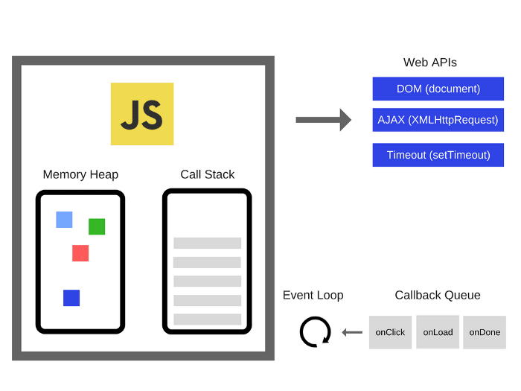
Event Loops
4.
JavaScript under the hood (V8)

Slide 8
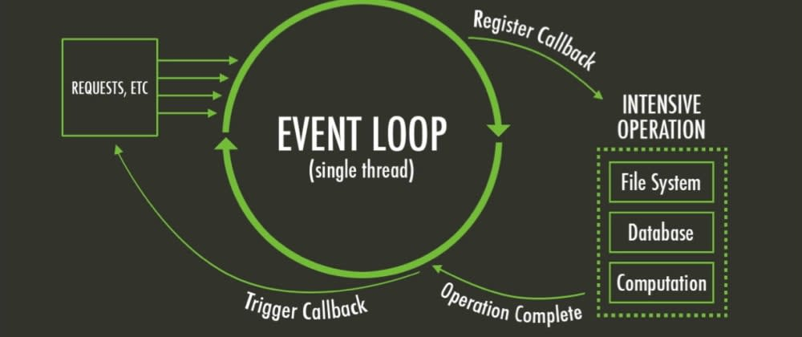
Event Loops

Slide 9
Non-blocking I/O
5.
Traditional I/O
Non Traditional I/O
let result = db.query(‘select * from users’);
doSomethingWith(result); // waits for result
doSomethingWithoutResult(); // blocked
db.query(‘select * from users’,
function (err, result) {
if(!err)
doSomethingWith(result);
// waits for result
});
doSomethingWithoutResult(); // executed without any delay

Slide 10
When to use Node.js?
6.
Streaming applications and static file servers.
Chat applications using WebSockets.
Skilled at JS so that you can use it for both client and server side code.
Server side rendering with React / Angular / other web UI libraries / frameworks.

Slide 11
When to not use Node.js?
7.
For heavy computations (event loops hog CPU).
If you prefer static typed over dynamic.
If you hate JavaScript.
No match for Spring boot, Django, Golang etc.

Slide 12
Let’s review some concepts
Background and Introduction
V8
Event Loops
Non blocking I/O
When and when not to use Node.js
Now let’s build some stuff 😉

Slide 13
What Next?
Express - a node.js framework to build APis in a flash ⚡.
EJS or Jade - UI template system for rendering dynamic HTML.
Socket.io - Web sockets and polling.
Nodemon - Hot reloading for development.
PM2 - Process management for Node.js
Chai and Mocha - Unit testing for Node.js

Slide 14
Thanks!
Any questions?
You can find me at
@adithya__nr
adithya.ramamurthy@betsol.com
adithyabhat.com (a shameless plug)

